Slide 1
COVID Deaths & Societal Factors– Executive Presentation
Date: April 9, 2021
Presenter: Elizabeth Miller

Slide 2
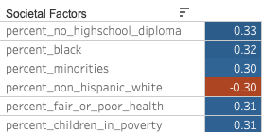
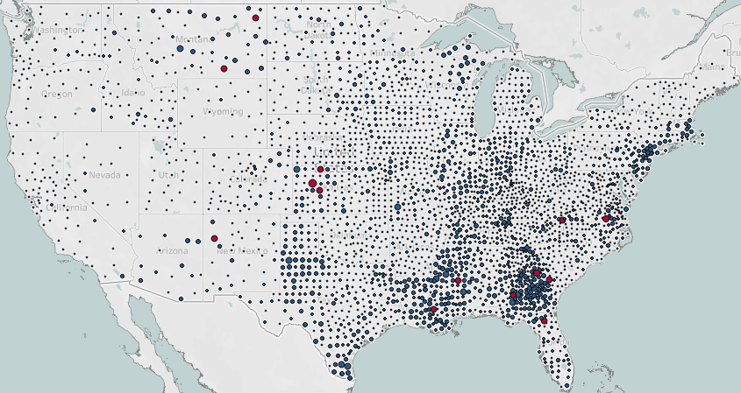

Executive Summary: Which societal factors correlate with COVID death rate in US counties and have value in predicting the geographical areas where most help is needed?
Correlation with COVID death rate
In the dataset¹, societal factors most strongly correlated with COVID death rate in US counties were percent of population:
Without a high school diploma
Black American
Fair or poor health status
Children in poverty
Non-Hispanic white (negative correlation)
Most of the counties with COVID death rates greater than 0.37%, shown in red below, are in the south region, where higher percentages of the population fall into the top four attributes above.
Coefficient
The Long-Term Viability and Productivity of Our Nation Depend On
Healthcare and policy to redress the persistent effects of structural and institutional racism
Family and community services to support youth in finishing school
Ready access for all to nutritious food and healthcare
Death rate due to COVID in US counties^{2,3}
¹ https://bit.ly/3mKbdoo, https://bit.ly/3wYWc71
²Latest date COVID data collected: 12/4/2020
³AK, HI: https://tabsoft.co/3dYTbuA

Slide 3
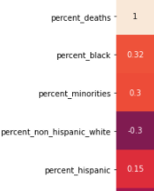
Among the categories of societal factors examined, the racial percentages of counties account for three of the five strongest predictors of COVID death rate.
Correlation with COVID death rate
Coefficient
Percent Black population links relatively strongly with COVID death rate.
Percent minorities follows close behind.
Counties with higher percentage white residents have a tendency toward lower COVID death rates.
Percent Black accounts for most of the percent minorities correlation:​
Percent Latinx (Hispanic) makeup of counties is shown to correlate with COVID death rate at a mild 0.15; other races at almost 0.
Sources: https://bit.ly/3mKbdoo, https://bit.ly/3wYWc71

Slide 4
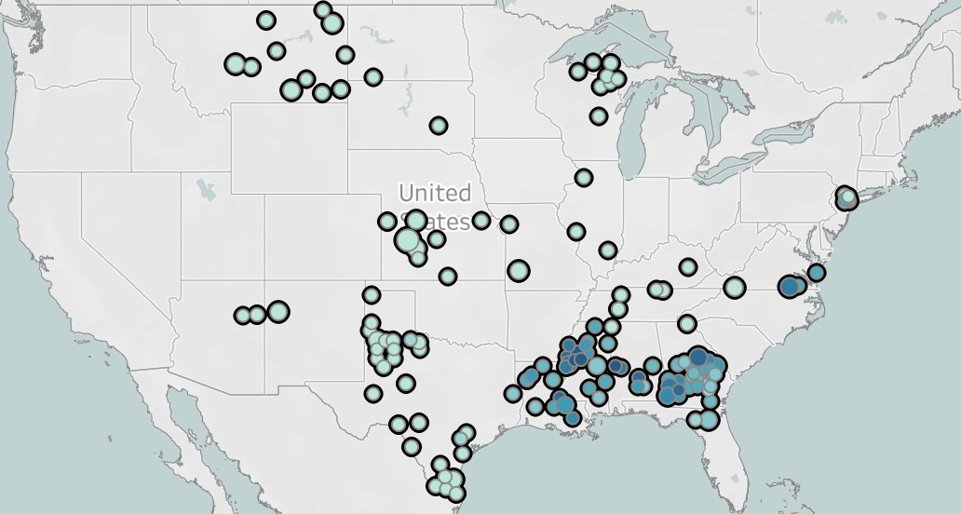
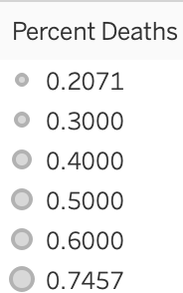
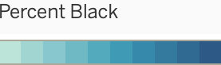
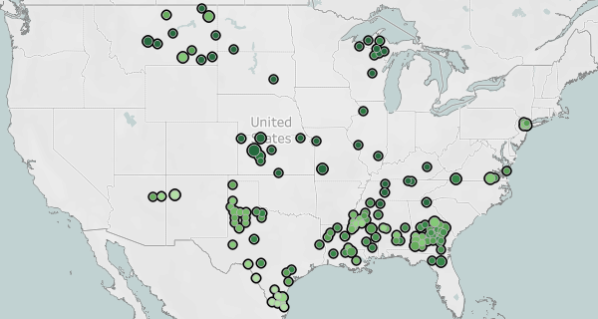

Structural racism persists: many counties with comparatively high COVID death rates have higher Black populations and lower white ones.¹
Maps are filtered for COVID death rate of 0.2% or more.
Not all counties with higher death rates (larger circles) have a higher percent Black population, but many do, and they are in the south region.
Some counties with the highest death rates (larger circles) are also a high percentage white. However, most of the counties in the upper range of COVID death rate have a lower percentage of white residents (south region).
Counties shown in the southwest have comparatively high percentage Latinx population. This attribute shows a mild (0.15) coefficient of correlation with COVID death rate in the dataset.
Address racial disparity
Focus medical treatment on access and equity, with provider training²
¹ https://bit.ly/3mKbdoo , https://bit.ly/3wYWc71
²https://www.commonwealthfund.org/publications/newsletter-article/2021/jan/medical-mistrust-among-black-americans

Slide 5
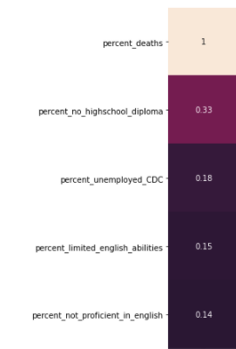
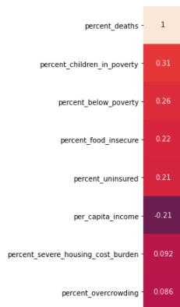
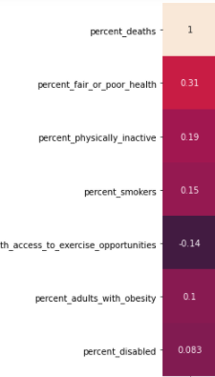
Factors related to education, income, and health status also rank as strong predictors of death rate due to COVID.¹
Percent population with no high school diploma showed the strongest correlation with US county COVID death rates.
These vulnerable counties should receive educational support.
Many income-related county population variables correlated at over an absolute value of 0.2 with COVID death rate.² Percent fair or poor health was more strongly correlated at 0.31.
Correlation with COVID death rate
Correlation with COVID death rate
Correlation with COVID death rate
Coefficient
Coefficient
Coefficient
¹ https://bit.ly/3mKbdoo , https://bit.ly/3wYWc71
²Measures above the note-worthy correlation coefficient parameter of 0.2 as defined by Chris Hui, Springboard course founder

Slide 6
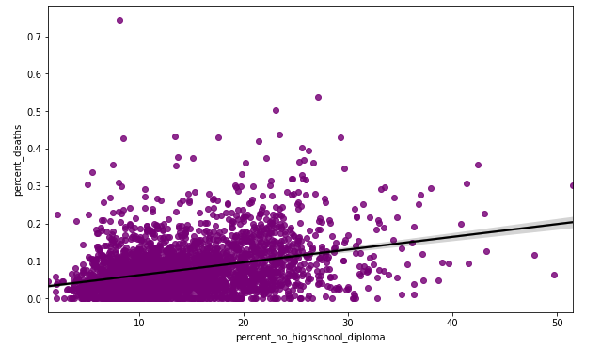
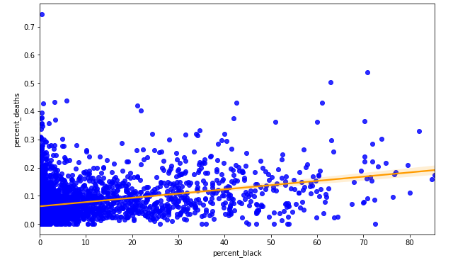
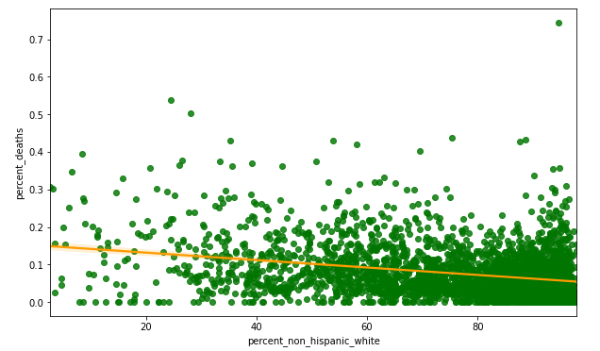
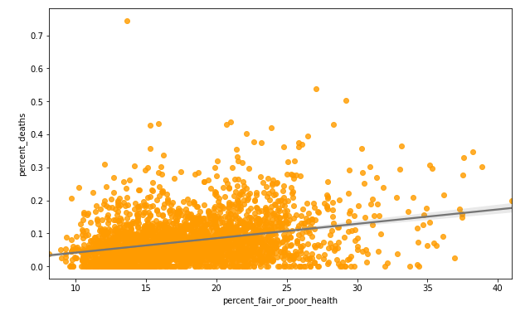
The strongest predictors of COVID death rate in US counties relate to education, race, and health status.
Each plot shows variables correlating most strongly with COVID death rate in counties:
percent no high school diploma (purple)
percent Black (blue)
percent white (green)
percent fair or poor health (orange)
These are the significant factors the data tells us to think about.

Slide 7
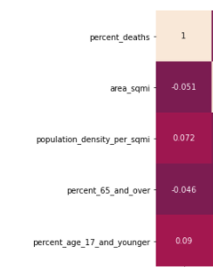
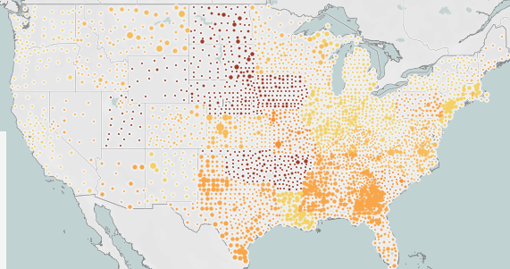
Societal factors in US counties not linked to COVID death rate: percent over age 65, population density. Timing of stay-at-home order shows small relationship.
Correlation with COVID death rate
Stay-at-home order date by county
Coefficient
Stay at home start: days after 3/17/20
0-7
7-14
14-21
No order
In addition to COVID death rate and societal factors already explored, maps in this presentation show population density, counties closer together in the east & south. However, this is not likely to account for higher COVID death rate, as we did not find a correlation in the dataset with density or overcrowding.
In the map, larger circles denote higher COVID death rates. While later stay at home orders and higher death rates do not always occur together, they are mildly linked at a correlation coefficient of 0.15.
Later orders correlated strongly with percent Black (0.34) and negatively with percent white (-0.24). It may be that governments still have a comparatively stronger commitment to saving white lives.
Correlation with COVID death rate
 | Coefficient
Later order, | 0.15
Correlation with later orders
 | Coefficient
perc_black | 0.34
perc_white | -0.24
Address racial disparity
Raise government commitments to saving Black lives.
Stay at home order information: https://ephtracking.cdc.gov/DataExplorer/

Slide 8
Recommendations
Risk Profile
Counties with higher percentage populations of the following tend to be more vulnerable to COVID death:
Without a high school diploma
Black American
Children in poverty
In fair or poor health
The US south region holds many, though not all, counties with one or more aspects of this risk profile.
States historically invested the longest in slavery made fewer public good expenditures.
Inequalities persist today, impacting those less access to healthcare and education, as well as Black, and low-income populations.¹
Recommendations with focus on US south first
Interventions to improve COVID outcomes and long-term health and productivity:
Education, health care, nutritious food for all citizens
Living wage, subsidized child-care
In medical settings²:
Empathy training for providers toward all races
Clinician/ patient conversations sharing personal stories about medical treatment
Asking patients their preferences
Giving refunds in response to a bad experience
¹ McGhee, Heather. _The Sum of Us: What Racism Costs Everyone and How We Can Prosper Together.
²_https://www.commonwealthfund.org/publications/newsletter-article/2021/jan/medical-mistrust-among-black-americans

Slide 9
Sources
Links to sources
The dataset
https://www.kaggle.com/johnjdavisiv/us-counties-covid19-weather-sociohealth-data
CDC COVID death by county
https://www.cdc.gov/nchs/covid19/covid-19-mortality-data-files.htm
CDC stay-at-home order information
https://ephtracking.cdc.gov/DataExplorer/
New York Times COVID case and death counts
https://github.com/nytimes/covid-19-data
Kaiser Family Foundation (stay at home orders)
https://www.kff.org/policy-watch/stay-at-home-orders-to-fight-covid19/
County Health Rankings
https://www.countyhealthrankings.org/
Correlation between age and COVID deaths
https://www.ncbi.nlm.nih.gov/pmc/articles/PMC7335648/#:~:text=Among%20COVID-19%20patients%2C%20elderly,respectively%20%5B5%2C
Research showing differentially worse medical treatment of Black Americans; suggested interventions
https://www.commonwealthfund.org/publications/newsletter-article/2021/jan/medical-mistrust-among-black-americans

Slide 10
Sources, continued
Undertreatment for pain
https://pubmed.ncbi.nlm.nih.gov/22239747/
McGhee, Heather. _The Sum of Us: What Racism Costs Everyone and How We Can Prosper Together._
Kaiser Family Foundation: uninsured statistics
https://www.kff.org/uninsured/issue-brief/key-facts-about-the-uninsured-population/
Pew Research 63% of US thinks there should be one government program that provides health care coverage
https://www.pewresearch.org/fact-tank/2020/09/29/increasing-share-of-americans-favor-a-single-government-program-to-provide-health-care-coverage/
Population density has not been connected to COVID death rate
https://www.scientificamerican.com/article/population-density-does-not-doom-cities-to-pandemic-dangers/
https://www.huffpost.com/entry/covid-19-population-density-myth_n_5ff8c68fc5b63642b6fba9eb

